Slide 1
Chapter 10: Memory Interface – Part II

Slide 2
10–2 ADDRESS DECODING
In order to attach a memory device to the microprocessor, it is necessary to decode
the address sent from the microprocessor.
Decoding makes the memory function at a unique section or partition of the memory map.
Without an address decoder, only one
memory device can be connected to a microprocessor, which would make it
virtually useless.

Slide 3
Why Decode Memory?
The 8088 has 20 address connections and
the 2716 EPROM has 11 connections.
The 8088 sends out a 20-bit memory
address whenever it reads or writes data.
  because the 2716 has only 11 address pins,
  there is a mismatch that must be corrected
The decoder corrects the mismatch by decoding address pins that do not connect
to the memory component.

Slide 4
Simple NAND Gate Decoder
When the 2K × 8 EPROM is used, address connections A₁₀–A₀ of 8088 are connected
to address inputs A₁₀–A₀ of the EPROM.
  the remaining nine address pins (A₁₉–A₁₁)
  are connected to a NAND gate decoder
The decoder selects the EPROM from one of the 2K-byte sections of the 1M-byte memory system in the 8088 microprocessor.
In this circuit a NAND gate decodes the memory address, as seen in Figure 10-13.

Slide 5
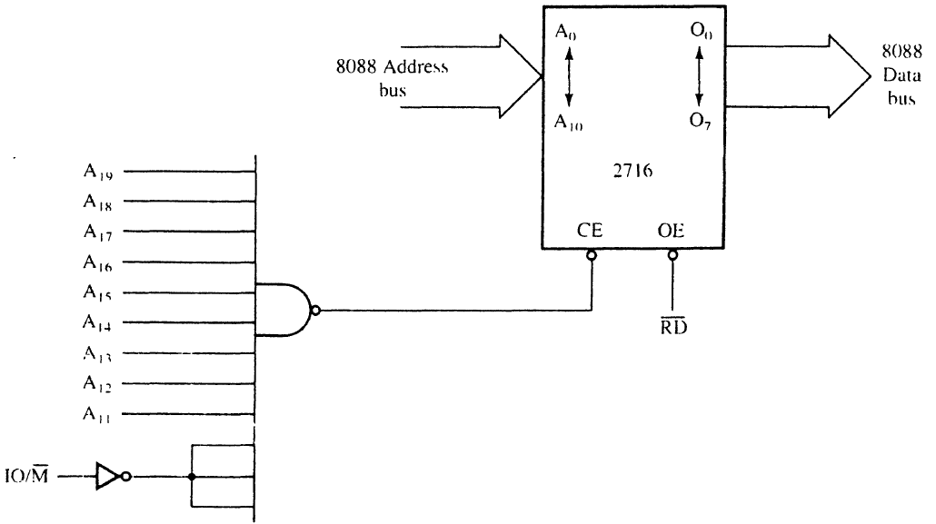
Figure 10–13 A simple NAND gate decoder that selects a 2716 EPROM for memory location FF800H–FFFFFH.

Slide 6
If the 20-bit binary address, decoded by the NAND gate, is written so that the leftmost nine bits are 1s and the rightmost 11 bits are don’t cares (X), the actual address range of the EPROM can be determined.
  a don’t care is a logic 1 or a logic 0, whichever
  is appropriate
Because of the excessive cost of the NAND gate decoder and inverters often required,
this option requires an alternate be found.

Slide 7
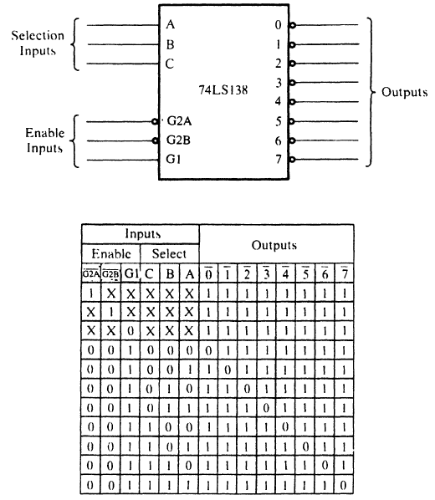
Figure 10–14 The 74LS138 3-to-8 line decoder and function table.
The 3-to-8 Line Decoder (74LS138)
  a common integrated circuit decoder found in many systems is the 74LS138 3-to-8 line decoder.

Slide 8
Sample Decoder Circuit
The outputs of the decoder in Figure 10–15, are connected to eight different 2764 EPROM memory devices.
The decoder selects eight 8K-byte blocks of memory for a total capacity of 64K bytes.
This figure also illustrates the address range of each memory device and the common connections to the memory devices.

Slide 9
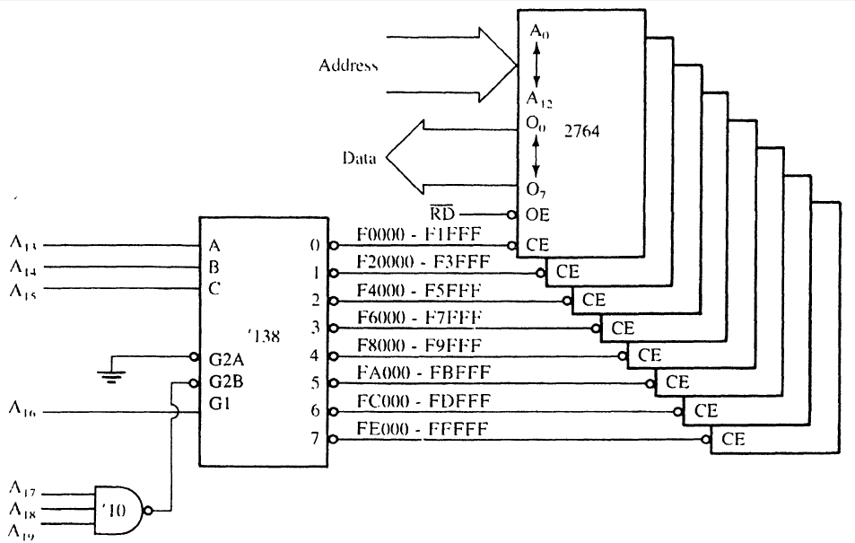
Figure 10–15 A circuit that uses eight 2764 EPROMs for a 64K × 8 section of memory in an 8088 microprocessor-based system. The addresses selected in this circuit are F0000H–FFFFFH.

Slide 10
Figure 10–15 A circuit that uses eight 2764 EPROMs for a 64K × 8 section of memory in an 8088 microprocessor-based system. The addresses selected in this circuit are F0000H–FFFFFH.
  all address connections from the 8088 are connected to this circuit.
  the decoder’s outputs are connected to the CE inputs of the EPROMs,
  the RD signal from the 8088 is connected to the OE inputs of the
  EPROMs

Slide 11
In this circuit, a three-input NAND gate is connected to address bits A₁₉–A₁₇.
When all three address inputs are high, the output of this NAND gate goes low and enables input G2B of the 74LS138.
Input G1 is connected directly to A₁₆.
In order to enable this decoder, the first four address connections (A₁₉–A₁₆) must all be high.

Slide 12
Address inputs C, B, and A connect to microprocessor address pins A₁₅–A₁₃.
These three address inputs determine which output pin goes low and which EPROM is selected whenever 8088 outputs a memory address within this range to the memory system.

Slide 13
The Dual 2-to-4 Line Decoder (74LS139)
Figure 10–16 illustrates both the pin-out and the truth table for the 74LS139 dual 2-to-4
line decoder.
74LS139 contains two separate 2-to-4 line decoders—each with its own address, enable, and output connections.

Slide 14
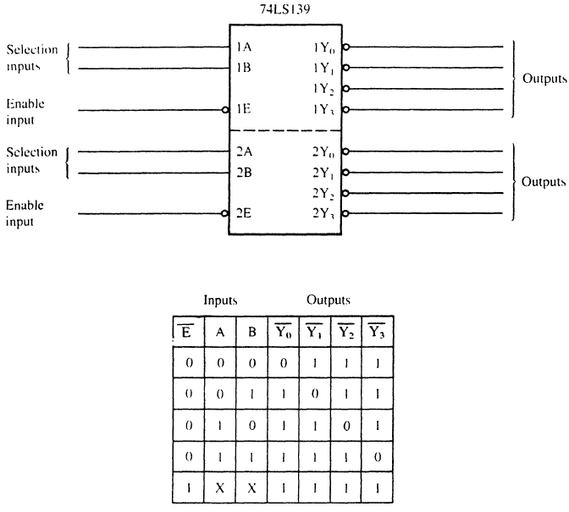
Figure 10–16 The pin-out and truth table of the 74LS139, dual 2-to-4 line decoder.

Slide 15
PLD Programmable Decoders
Three SPLD (simple PLD) devices function in the same manner but have different names:
  PLA (programmable logic array)
  PAL (programmable array logic)
  GAL (gated array logic)
In existence since the mid-70s, they have appeared in memory system and digital designs since the early 1990s.

Slide 16
PAL and PLA are fuse-programmed, and some PLD devices are erasable devices.
  all are arrays of programmable logic elements
Other PLDs available:
  CPLDs (complex programmable logic devices)
  FPGAs (field programmable gate arrays)
  FPICs (field programmable interconnect)
These PLDs are more complex than the SPLDs used more commonly in designing
a complete system.

Slide 17
If the concentration is on decoding addresses, the SPLD is used.
If the concentration is on a complete system, then the CPLD, FPLG, or FPIC is used to implement the design.
These devices are also referred to as an ASIC (application-specific integrated circuit).

Slide 18
Combinatorial Programmable Logic Arrays
Fig 10–18 shows the internal structure of a PAL16L8 constructed with AND/OR gate logic.
It has 10 fixed inputs, two fixed outputs, and six pins programmable as inputs or outputs.
Programming is accomplished by blowing fuses to connect inputs to the OR gate array.
It is ideal as a decoder because of its structure, also because outputs are active low.

Slide 19
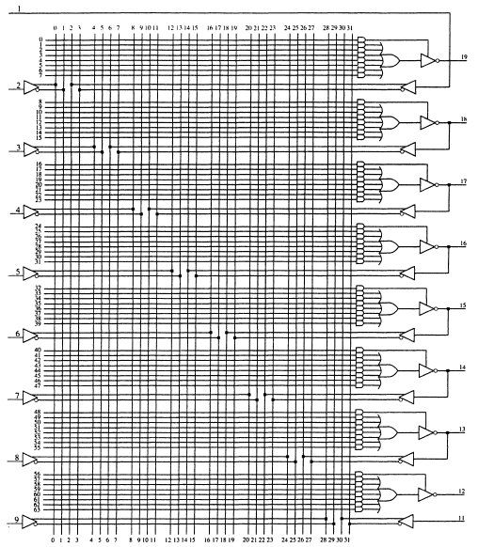
Figure 10–18 The PAL16L8.

Slide 20
A PAL is programmed with software such
as PALASM, the PAL assembler program.
PLD design is accomplished using HDL (hardware description language) or
VHDL (verilog HDL).
  VHDL and its syntax are currently the industry standard for programming PLD devices
Various editors attempt to ease the task of defining the pins.
  the authors believe it is easier to use NotePad

Slide 21
Comments in VHDL begin with a pair of
minus signs as illustrated in the first line
of the VHDL code in Example 10–5.
  the library and use statements specify the standard IEEE library using standard logic
The entity statement names the VHDL module, in this case DECODER_10_17.
The port statements define the in, out, and in-out pins used in the equations for the logic expression, which appears in the begin block.

Slide 22
The architecture statement merely refers to the version (V₁) of this design.
Equations for the design are placed in the begin block.
  each output pin has its own equation
The keyword not is used for logical inversion and the keyword and is used for the logical and operation.

Slide 23
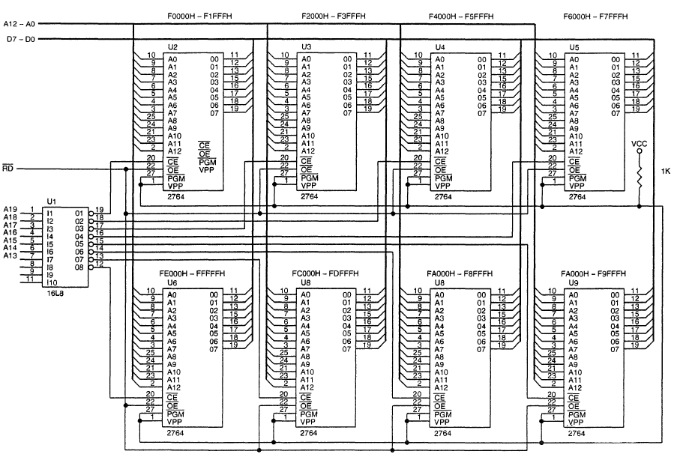
Figure A PAL16L8 that decodes 8 2764 (8K x 8) memory devices.

Slide 24
10–3 8088 and 80188 (8-bit) MEMORY INTERFACE
In this section, we examine the memory interface to both RAM and ROM and explain the error-correction code (ECC), which is still is currently available to memory system designers.
Many home computer systems do not use ECC because of the cost, but business machines often do use it.

Slide 25
Basic 8088/80188 Memory Interface
8088/80188 microprocessors have an 8-bit data bus, which makes them ideal to connect to common 8-bit memory devices available.
For the 8088/80188 to function correctly with memory, however, the system must decode the address to select a memory component.

Slide 26
Interfacing EPROM to the 8088
Fig 10–20 shows an 8088/80188 connected to eight 2732 EPROMs, 32K × 8 devices.
  74HCT138 decoder in this illustration decodes eight 4K × 8 blocks of memory for a total of 32K × 8 bits of physical address space for 8088/80188
The decoder is selected for an address range that begins at F8000H and continues through location FFFFFH—the upper 32K bytes of memory.

Slide 27
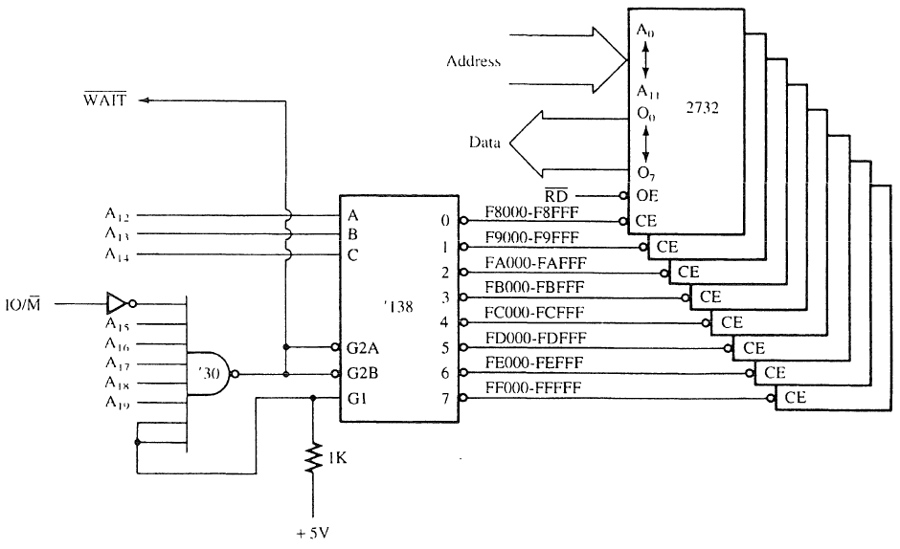
Figure 10–20 Eight 2732 EPROMs interfaced to the 8088 microprocessor.

Slide 28
This section of memory is an EPROM because FFFF0H is where the 8088 starts to execute instructions after a hardware reset.
  often called the cold-start location
The software stored in this section of memory would contain a JMP instruction at location FFFF0H that jumps to location F8000H
  so the remainder of the program can execute

Slide 29
Interfacing RAM to the 8088
RAM is easier to interface than EPROM as most RAM does not require wait states.
  ideal section of memory for RAM is the very bottom, which contains vectors for interrupts
Interrupt vectors are often modified by software packages,
  it important to encode this section of the
  memory with RAM
Fig 10–21 shows sixteen 62256 static RAMs interfaced to the 8088, beginning at 00000H.

Slide 30
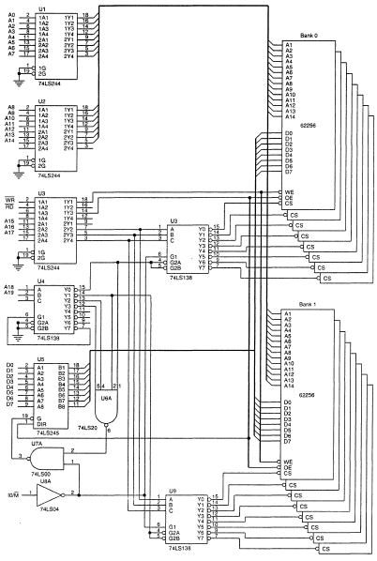
Figure 10–21 A 512K-byte static memory system using 16 62255 SRAMs.
this board uses two decoders to select 16 RAM components, and a third to select other decoders for the appropriate memory sections
sixteen 32K RAMs fill memory from 00000H through 7FFFFH, for 512K bytes memory.

Slide 31
Interfacing Flash Memory
Becoming commonplace for storing setup information on video cards, and the system BIOS in the personal computer.
  also in MP3 players and USB pen drives
Flash memory is also found in many other applications to store information that is only changed occasionally.

Slide 32
The difference between flash memory and SRAM is that flash requires 12V programming voltage to erase and write new data.
The newest versions of flash memory are erased with a 5.0V or even a 3.3V signal
  so a converter is not needed
EEPROM is available as a memory device with a parallel or serial interface.
Serial is too small for memory expansion, but as an I/O it can store information.
  such as in a flash drive.

Slide 33
Fig 10–22 shows a 28F400 flash memory interfaced to an 8088 parallel interface.
  28F400 can be used as a 512K × 8 memory device or as a 256K × 16 memory device
  because it is interfaced to an 8088, the configuration is 512K × 8
Control connections on this device are identical to that of an SRAM.
New pins are for erase and programming; selecting power-down mode when a logic 0; and selecting byte or word operation.

Slide 34
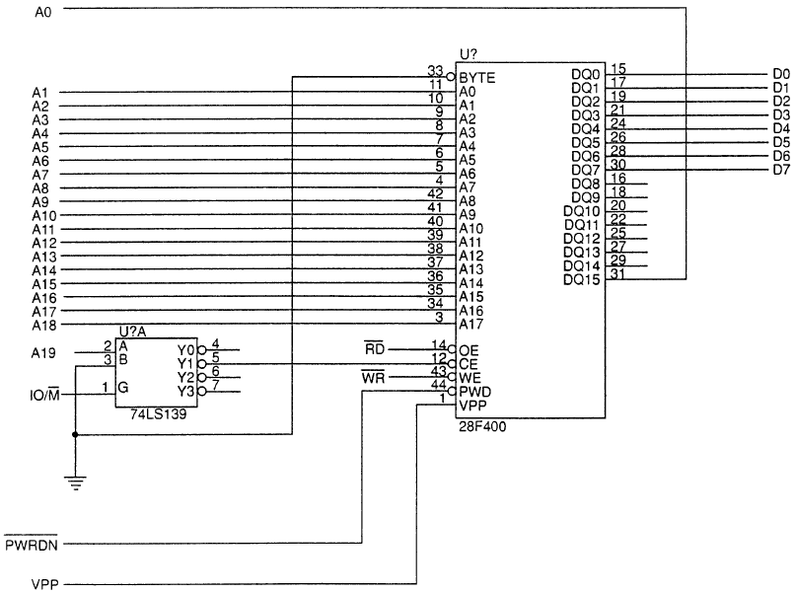
Figure 10–22 The 28F400 flash memory device interfaced to the 8088 microprocessor.

Slide 35
Most modern flash memory functions from 5V or 3.3V without need for higher programming voltage, and has a long life span.
  1,000,000 erases with storage time of 200 years

Slide 36
Error Correction
Integrated circuit manufacturers have only recently produced error-correcting circuits.
One such is the 74LS636, an 8-bit error correction and detection circuit that corrects any single-bit memory read error and flags
any 2-bit error called SECDED (single error correction/double error dorrection).
This device is found in high-end computer systems because of the cost of implementing a system that uses error correction.

Slide 37
Newest systems are now using DDR memory with ECC (error-correction code).
The 74LS636 corrects errors by storing five parity bits with each byte of memory data.
  automatic error correction for single-bit errors
If more than two bits are in error, this circuit may not detect it.
When a memory component fails completely, its bits are all high or all low.
In this case, the circuit flags the processor with a multiple-bit error indication.

Slide 38
Fig 10–25 depicts pin-outs of the 74LS636.
  it has eight data I/O pins
  five check bit I/O pins
  two control inputs (SO and SI)
  two error outputs: single-error flag (SEF) and double-error flag (DEF)
When a single error is detected, 74LS636 goes through an error-correction cycle.
It places a 01 on S₀ and S₁ by causing a wait and then a read following error correction.

Slide 39
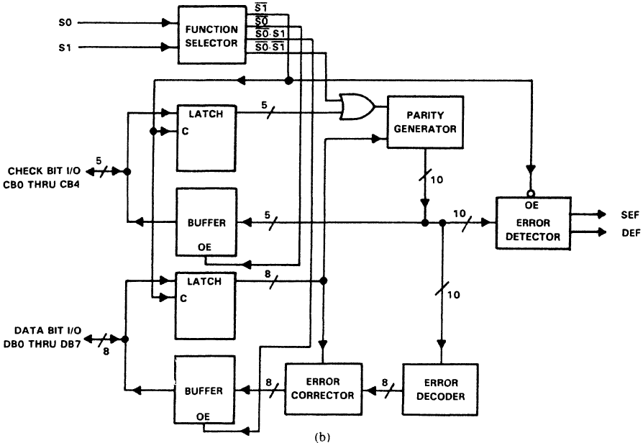
Figure 10–25 (a) The pin connections of the 74LS636. (b) The block diagram of the 74LS636. (Courtesy of Texas Instruments Incorporated.)

Slide 40
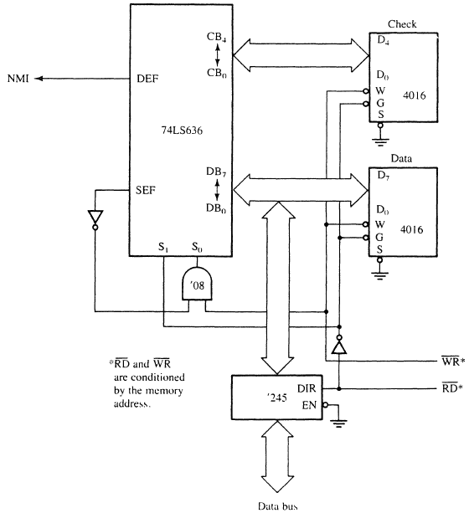
Figure 10–26 An error detection and correction circuit using the 74LS636.
  a circuit to correct single-bit errors with the 74LS636 and to interrupt the processor through the NMI pin for double-bit errors
  To simplify we depict only one 2K × 8 RAM and a second 2K × 8 RAM to store the 5-bit check code

Slide 41
Modern DDR error-correction memory (ECC) does not actually have logic circuitry on board that detects and corrects errors.
Since Pentium, the processor incorporates the logic to detect/correct errors provided the memory can store the extra 8 bits required
for storing the ECC code.
ECC memory is 72-bits wide using the additional 8 bits to store the ECC code.
If an error occurs, the microprocessor runs the correction cycle to correct the error.

Slide 42
Some memory devices such as Samsung memory also perform an internal error check.
The Samsung ECC uses 3 bytes to check every 256 bytes of memory, which is far
more efficient.
Additional information on the Samsung
ECC algorithm is available at the
Samsung website.

Slide 43
10–4 8086, 80186, 80286, & 80386SX (16-Bit) MEMORY INTERFACE
8086, 80186, 80286, and 80386SX differ from the 8088/80188 in three ways:
  the data bus is 16 bits instead of 8 bits wide
  the IO/M pin of the 8088 is replaced with an
  M/IO pin
  a new control signal called bus high enable
80286/80386SX contains a 24-bit address bus (A₂₃–A₀) instead of A 20-bit address bus (A₁₉–A₀) of the 8086/80186.

Slide 44
16-Bit Bus Control
The data bus of 8086, 80186, 80286, and 80386SX is twice as wide as for the 8088/80188.
  the wider bus presents a unique set of problems
  processors must be able to write data to any
  16-bit location—or any 8-bit location
This means the 16-bit data bus must be divided into two separate sections (or banks) 8 bits wide so that the processor can write to either half (8-bit) or both halves (16-bit).

Slide 45
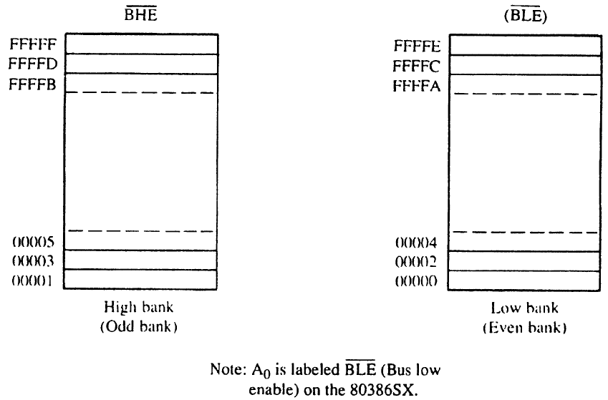
Figure 10–27 The high (odd) and low (even) 8-bit memory banks of the 8086/80286/80386SX microprocessors.

Slide 46
Bank selection is accomplished in two ways:
  separate write signal is developed to select a write to each bank of the memory
  separate decoders are used for each bank
The first technique is by far the least costly approach to memory interface.
The second technique is only used in a system that must achieve the most efficient use of the power supply.

Slide 47
Separate Bank Decoders
Separate bank decoders is often the least effective way to decode memory addresses
for the 8086, 80186, 80286, and 80386SX.
This method is sometimes used, but it is difficult to understand why in most cases.
  one reason may be to conserve energy,
  as only banks selected are enabled
Fig 10–28 shows two 74LS138s used to
select 64K RAM memory components for the 80386SX microprocessor (24-bit address).

Slide 48
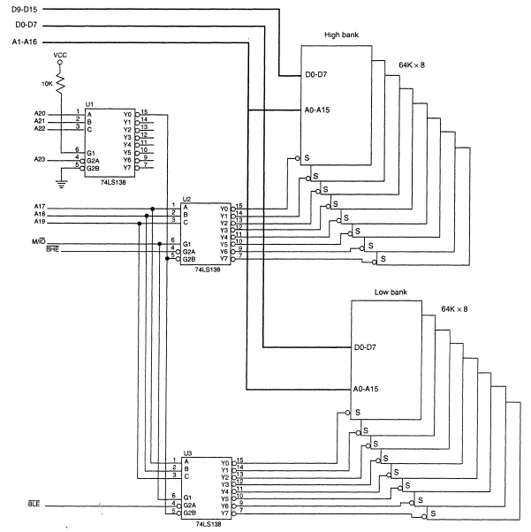
Figure 10–28 Separate bank decoders.

Slide 49
Separate Bank Write Strobes
The effective way to handle bank selection
is a separate write strobe for each bank.
  this requires only one decoder to select a 16-bit-wide memory, which saves money
Fig 10–29 depicts generation of separate
8086 write strobes.
Separate read strobes for each bank are usually unnecessary because 8086 through 80386SX read only the byte of data they need at any given time from half of the data bus.

Slide 50
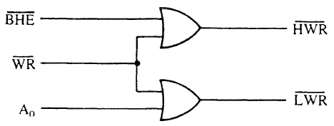
Figure 10–29 The memory bank write selection input signals: HWR (high bank write) and LWR (low bank write).
  a memory system that uses separate write strobes is constructed differently from the 8088 or the system using separate memory banks
  memory in a system using separate write strobes is decoded as 16-bit-wide

Slide 51
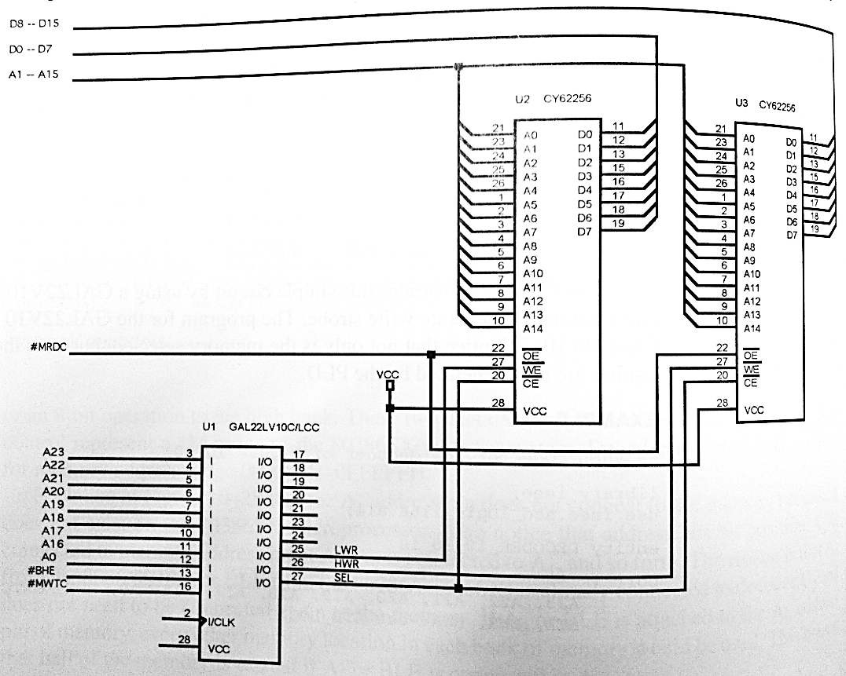
Figure 10–30 A 16-bit-wide memory interfaced at memory locations 06000H–06FFFH.
  a 16L8 to both decode memory and generate the separate write strobe
  notice that not only is the memory selected, but both the lower and upper write strobes
  are also generated by the PLD

Slide 52
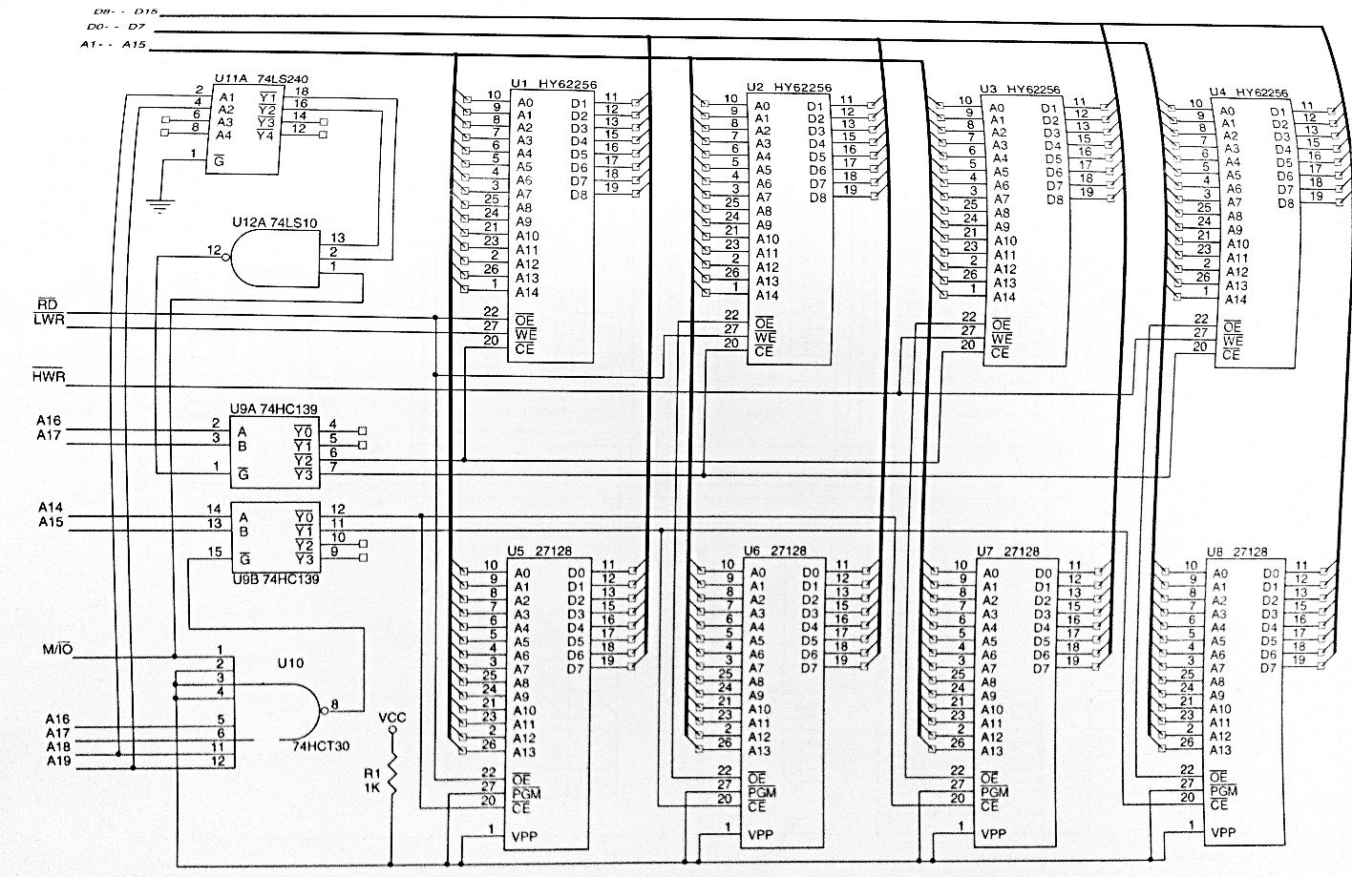
Figure 10–31 A memory system that contains a 64KB EPROM and a 128KB SRAM.

Slide 53
Fig 10–32 shows a memory connected to an 80386SX by using a GAL22V10 as a decoder.
This interface contains 256K bytes of EPROM in the form of four 27512 (64K × 8) EPROMs and 128K bytes of SRAM memory found in four 62256 (32K × 8) SRAMs.
The PLD decodes the 16-bit-wide memory addresses at locations 000000H–01FFFFH for the SRAM and locations FC0000H–FFFFFFH for the EPROM.

Slide 54
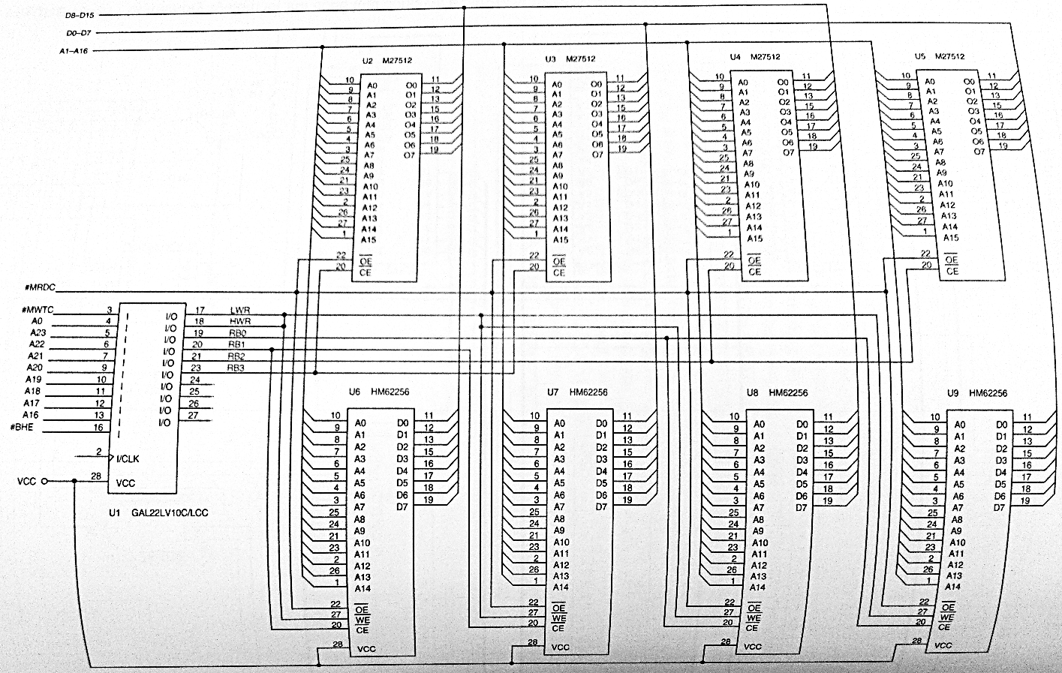
Figure 10–32 An 80386SX memory containing 256K of EPROM and 128K of SRAM.

Slide 55
10–7 DYNAMIC RAM
Because RAM is often large, it requires many SRAMs at great cost or a few DRAMs (dynamic RAMs) at much reduced cost.
IC manufacturers have provided a dynamic RAM controller with address multiplexers
and timing circuitry necessary for refreshing.
This section of the text covers the DRAM
and provides information on the use of a dynamic controller in a memory system.

Slide 56
DRAM Revisited
DRAM must be refreshed periodically as it stores data internally on capacitors that lose charge in a short period of time.
  to refresh DRAM, contents of a section of the memory must periodically be read or written
Any read or write automatically refreshes an entire section of the DRAM.
The number of bits refreshed depends on the size of the memory component and its internal organization.

Slide 57
Refresh cycles are done with a read, write, or a special refresh that doesn’t read or write.
The refresh cycle is internal to the DRAM and often accomplished while other memory components in the system operate.
  this is called hidden refresh, transparent refresh, or sometimes, cycle stealing
To do a hidden refresh while other memory components are functioning, an RAS -only cycle strobes a row address into the DRAM
to select a row of bits to be refreshed.

Slide 58
The RAS input also causes the selected row to be read and rewritten into the selected bits.
  this recharges internal capacitors that store data
This refresh is hidden from the system because it occurs while the processor is reading or writing other sections of memory

Slide 59
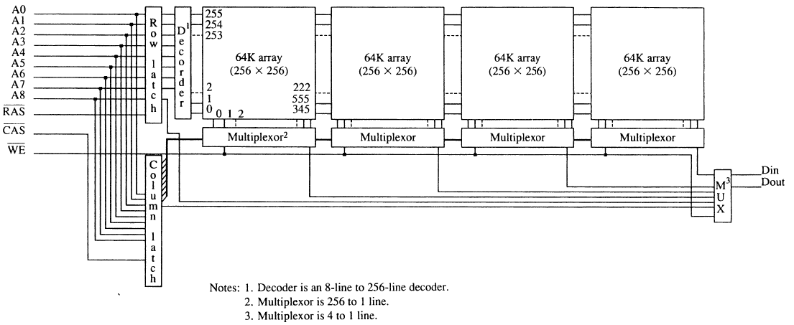
Figure 10–39 The internal structure of a 256K × 1 DRAM. Note that each of the internal 256 words are 1024 bits wide.
DRAM internal organization has a series of rows and columns
a 256K × 1 DRAM has 256 columns, each containing 256 bits, or rows organized into four sections of 64K bits
When memory is addressed, the column address selects a column (or internal memory word) of 1024 bits

Slide 60
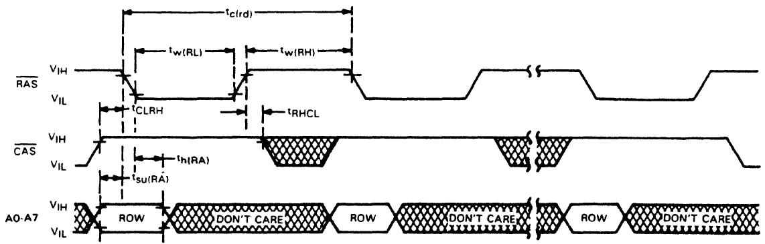
Figure 10–40 The timing diagram of the RAS refresh cycle for the TMS4464 DRAM. (Courtesy of Texas Instruments Corporation.)
the difference between the RAS and a read or write is that it applies only a refresh address, usually obtained from a 7- or 8-bit binary counter.
counter size is determined by type of DRAM being refreshed
refresh counter is incremented at the end of each refresh cycle
all rows are refreshed in 2 or 4 ms, depending on the DRAM

Slide 61
If there are 256 rows to be refreshed within 4 ms, the refresh cycle must be activated at least once every 15.6 µs.
  in a modern system such as a 3.0 GHz
  Pentium 4, 15.6 µs is a great deal of time
Since the 3.0 GHz Pentium 4 executes an instruction in about one-third ns, it can execute about 46,000 instructions
between refreshes.
In new machines much less than 1%
(≈0.002 %) is required for a refresh.

Slide 62
EDO Memory
Slight modification to the DRAM changes it an EDO (extended data output) DRAM device.
In EDO memory, any memory access, including a refresh, stores the 256 bits selected by RAS into latches.
This slight modification increases system performance by about 15% to 25%.
Although EDO memory is no longer available, the technique is employed in modern DRAM.

Slide 63
SDRAM
Synchronous dynamic RAM (SDRAM) is used with most newer systems because of speed.
Versions are available with access times as low as 7 ns, for the 133 MHz bus.
When a burst transfer occurs to the SDRAM from the processor, it takes three or four bus clocks before the first 64-bit number is read.
Each subsequent number is read without wait states and in one bus cycle each.

Slide 64
Because SDRAM bursts read four 64-bit numbers, the second through fourth require no waits, and can be read in one bus cycle each, SDRAM outperforms standard DRAM .
Most estimates place SDRAM at about a
10% performance increase over EDO memory.

Slide 65
DDR
Double-data rate (DDR) memory is the latest improvement in DRAM modifications.
  DDR memory data at double SDRAM speed because it transfers on each edge of the clock
  the positive edge is used for a transfer and so
  is the negative edge
Even though this seems as if it doubles the speed of the memory, it really does not.
  access time problems still exist, with even most advanced memory requiring access time of 40 ns.

Slide 66
DRAM Controllers
In most systems, a DRAM controller-IC performs address multiplexing and generation of the DRAM control signals.
  newer embedded processors, such as 80186/8, include refresh circuitry as part of the processor
Most modern computers contain the DRAM controller in the chip set so a stand-alone DRAM controller is not available.

Slide 67
The DRAM controller in the chip set for the microprocessor times refresh cycles and inserts refresh cycles into the timing.
The memory refresh is transparent to the microprocessor, because it really does not control refreshing.
For Pentium II, III, and P4, DRAM control is built in the chip set provided by Intel or AMD.
In the future, even the chip set will undoubtedly be built into the microprocessor.

